Slide 1
Chapter 6 Architectural Design

Slide 2
Lesson Objectives
Discuss why architectural design of software is important
Explain the 3 main activities in architectural design – overall system organization, modular decomposition and control modeling
Distinguish the models/styles involve in System Organization and Control Modeling

Slide 3
Why Architectural Design is Important?

Slide 4

Introduction
Large systems can be decomposed into sub-systems that provide some related set of services.
The initial design process of identifying these sub-systems and establishing a framework for sub-system control and communication is called architectural design.
Architectural design is the first stage in the design process and usually comes before detailed system specification.

Slide 5

Advantages of Explicit Architecture
Stakeholder communication
– used during discussion to show high-level presentation of system
System analysis
– check whether the system can meet critical requirements
Large-scale reuse
– The architecture may be reusable across a range of systems since it shows us how a system is organized and how the components interoperate.

Slide 6
Advantages of Explicit Architecture
4. Negotiation
Serve as design plan that can be used for negotiation & discussion

Slide 7

Advantages of Explicit Architecture
5. Complexity Management
Act as essential tool for complexity management

Slide 8
Architectural Design Activities
System Organization
Modular Decomposition
Control Modeling

Slide 9
1. System Organization/Structuring

Slide 10


1. System Organization/Structuring
Represented in Block Diagram
Sub-systems

Slide 11
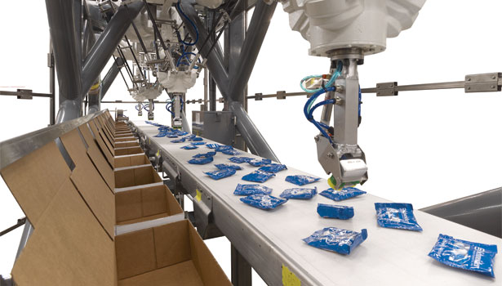
1. System Organization/Structuring
E.g. packing robot system

Slide 12
1. System Organization/Structuring
This is the first phase of the architectural design activity.
At its most abstract level, an architectural design may be depicted as a block diagram in which each box represents a sub-system, as shown in the following figure: (next slide)

Slide 13
1. System Organization/Structuring
Vision system
Object Identification System
Arm Controller
Gripper Controller
Packing Selection System
Conveyer Controller
Packing System

Slide 14
1. System Organization/Structuring
The system is structured into a number of principal sub-systems where a sub-system is an independent software unit.
Communications between sub-systems are also identified.
More specific models of the structure may be developed which show how sub-systems share data, how they are distributed and how they interface with each other.

Slide 15
1. System Organization/Structuring
3 widely used system organization styles/models are:
i) Repository model
ii) Client-server model
iii) Layered model

Slide 16
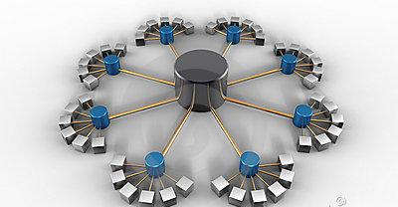
1. System Organization/Structuring
i) Repository Model
Sub-systems need to exchange data.
This may be done in two ways:
All shared data is held in a central database.
Each sub-system maintain its own database and interchange data by passing messages
When to use?
large amounts of data are to be shared, the repository model of sharing is most commonly used.

Slide 17
1. System Organization/Structuring
Repository Model -The architecture of an integrated CASE toolset
Project Repository
Design Editor
Code Generator
Program Editor
Report Generator
Design Analyzer
Design Translator

Slide 18
1. System Organization/Structuring
i) Repository Model
Advantages
Efficient way to share large amounts of data;
Sub-systems need not be concerned with how data is produced
Centralised management e.g. backup, security, etc.
Sharing model is published as the repository schema.

Slide 19
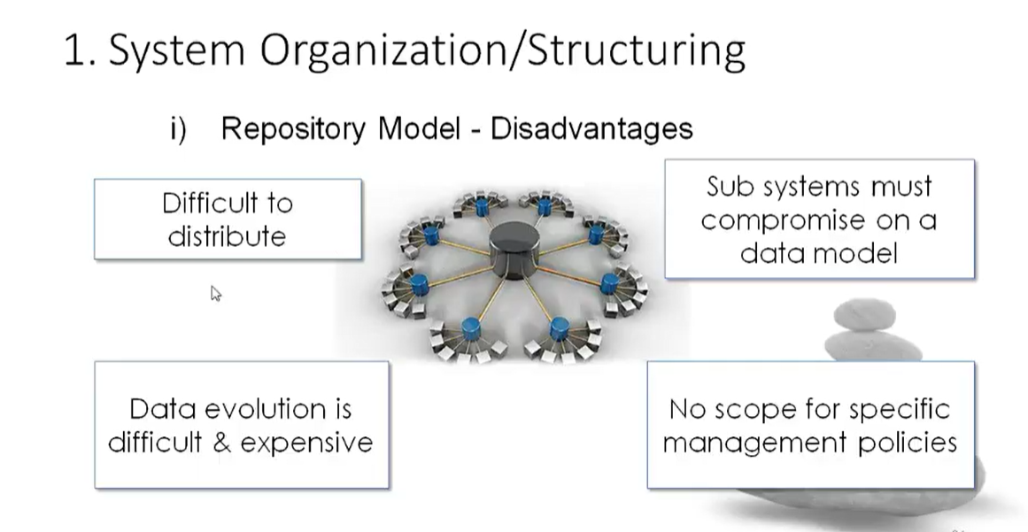
1. System Organization/Structuring
i) Repository Model
Disadvantages
Sub-systems must agree on a repository data model. Inevitably a compromise;
Data evolution is difficult and expensive;
No scope for specific management policies;
Difficult to distribute efficiently

Slide 20

1. System Organization/Structuring
Client-Server Model
ii) Client-Server Model
Distributed system model which shows how data and processing is distributed across a range of components.
Set of stand-alone servers which provide specific services such as printing, data management, etc.
Set of clients which call on these services.
Network which allows clients to access servers.

Slide 21
1. System Organization/Structuring
ii) Client-Server Model - The architecture of a film and picture library system
Client 1
Client 2
Client 3
Client 4
Wide-bandwidth network
Catalogue Server
Video Server
Picture Server
Hypertext Server
Catalogue
Film Clip Files
Digitized Photographs
Hypertext Web

Slide 22
1. System Organization/Structuring
Client-Server Model
ii) Client-Server Model
Advantages
Distribution of data is straightforward;
Makes effective use of networked systems. May require cheaper hardware;
Easy to add new servers or upgrade existing servers.
Disadvantages
No shared data model so sub-systems use different data organisation. Data interchange may be inefficient;
Redundant management in each server;
No central register of names and services - it may be hard to find out what servers and services are available.

Slide 23

1. System Organization/Structuring
iii) Layered Model
Also called abstract machine model
Used to model the interfacing of sub-systems.
Organises the system into a set of layers each of which provide a set of services
Supports the incremental development of sub-systems in different layers. When a layer interface changes, only the adjacent layer is affected

Slide 24
1. System Organization/Structuring
iii) Layered Model – Version Management System
Configuration management system layer
Object management system layer
Database system layer
Operating system layer

Slide 25

2. Modular Decomposition

Slide 26
2. Modular Decomposition
After an overall system organization has been chosen, you need to make a decision on the approaches to be used to decompose sub-systems into modules.
This is the decomposition of sub-systems into modules. The components in modules are usually smaller than sub-systems and this allows alternative decomposition models to be used.

Slide 27
2. Modular Decomposition
2 main strategies on decomposing a sub-system into modules:
i) Object-oriented decomposition
– an object model where decompose a system into a set of communicating objects
ii) Function-oriented decomposition
– an pipeline/ data-flow model where decompose a system into functional modules that accept input data and transform them into output data.

Slide 28
2. Modular Decomposition
Object-Oriented Decomposition – Invoice Processing System
Client
Receipt
CustomerNo
Name
Address
CreditPeriod
InvoiceNo
Date
Amount
CustomerNo
Invoice
InvoiceNo
Date
Amount
Customer
Payment
Issue()
sendReminder()
acceptPayment()
sendReceipt()
InvoiceNo
Date
Amount
CustomerNo

Slide 29
2. Modular Decomposition
Function-Oriented Decomposition – Invoice Processing System
Issue receipts
Receipts
Read issued invoices
Identify payments
Find payments due
Issue payment reminder
Invoices
Payments
Reminders

Slide 30
3. Control Modeling

Slide 31
3. Control Modeling
The models for structuring a system are concerned with how a system is decomposed into sub-systems. However, to work as a system, sub-systems must be controlled so that their services are delivered to the right place at the right time.
Structural/ Organizational models do not include control information.
Hence, a general model of the control relationships between the parts of the system is established
Concerned with the control flow between sub-systems

Slide 32

3. Control Modeling
i) Centralized control
Call-return model
Manager model
2 general control styles
ii) Event-based control
Broadcast model
Interrupt-driven model

Slide 33

3. Control Modeling
i) Centralized Control
One sub-system has overall responsibility for control and starts and stops other sub-systems.

Slide 34
3. Control Modeling
i) Centralized Control – Call-Return Model
Top-down subroutine model
Sequential systems

Slide 35
3. Control Modeling
i) Centralized Control – Call-Return Model
Main Program
Routine 1
Routine 2
Routine 3
Routine 1.1
Routine 1.2
Routine 3.1
Routine 3.2
→top down sub-routine model
→applicable for sequential systems

Slide 36

3. Control Modeling
Centralized Control – Manager Model
One system component is designated as system manager i.e. controls the stopping, starting and coordination of other system processes.
Applicable to concurrent systems.
Can be implemented in sequential systems as a case statement.

Slide 37
3. Control Modeling
i) Centralized Control – Manager Model
Sensor Processes
Computation processes
Actuator processes
System Controller
User interface
Fault handler
→ a system component is designated as system manager
→ processes(sub-systems) can execute concurrently
→ applicable for concurrent systems

Slide 38

3. Control Modeling
ii) Event-based Control
each sub-system can respond to externally generated events that might come from other sub-systems or environment.

Slide 39
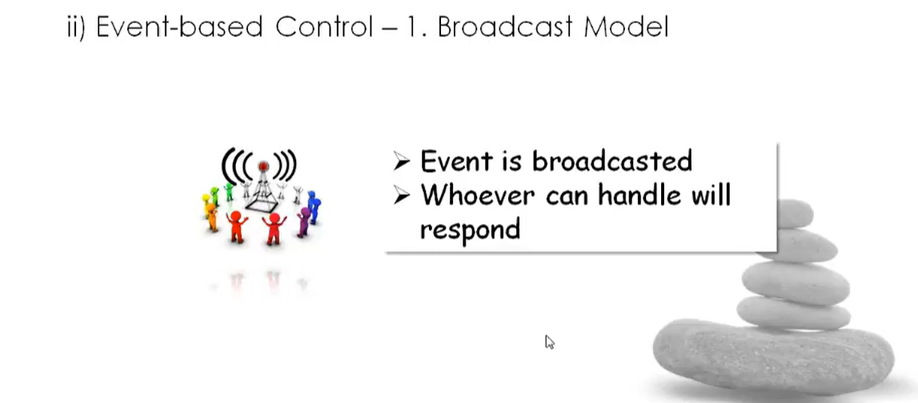

3. Control Modeling
ii) Event-based Control – 1. Broadcast Model
An event is broadcast to all sub-systems. Any sub-system which can handle the event may respond to it.
Effective in integrating sub-systems distributed across different computers on a network

Slide 40
3. Control Modeling
ii) Event-based Control – 1. Broadcast Model
Subsystem 1
Subsystem 2
Subsystem 3
Subsystem 4
Event and Message Handler
Event | Subsystem
E1 | SS1
E2 | SS2
E3 | SS3
E4 | SS4
→ an event is broadcast to all sub-systems
→ effective in integrating sub-systems distributed across different computers on a network

Slide 41
3. Control Modeling
ii) Event-based Control –
2. Interrupt-Driven Model
Used in real-time systems where interrupts are detected by an interrupt handler and passed to some other component for processing.

Slide 42
Revision
System organization
Structure the system into main sub-systems & identify their communication. What are the Models?
Modular Decomposition
Decompose sub-systems into modules. What are the models?
Control Modeling
Establish control relationship between sub-systems/ modules. What are the Models?

